Slide 1


Slide 2
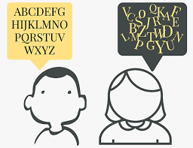
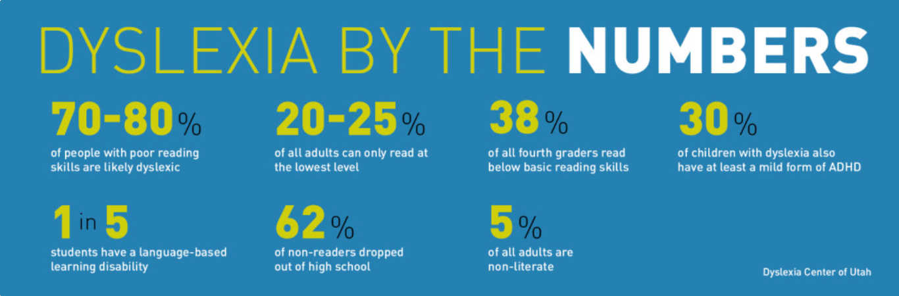
Challenges faced
It is estimated that 1 out of 10 people have dyslexia. That means that with a 7.8 billion global population, there are around 780 million people with dyslexia globally.

Slide 3
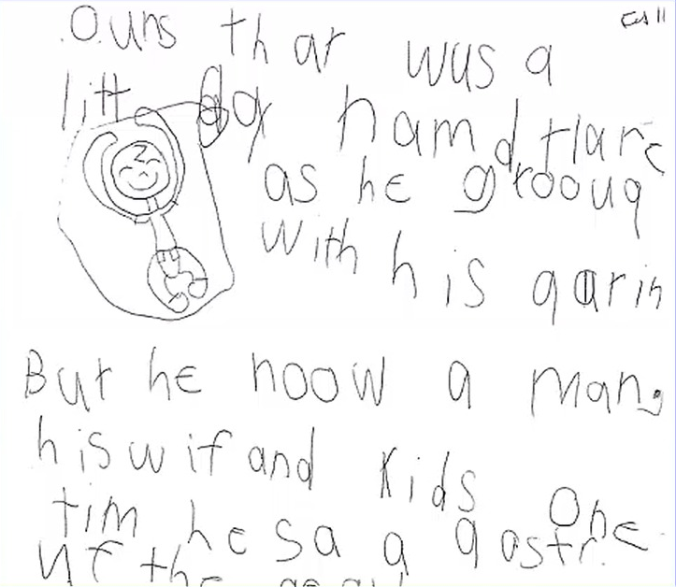
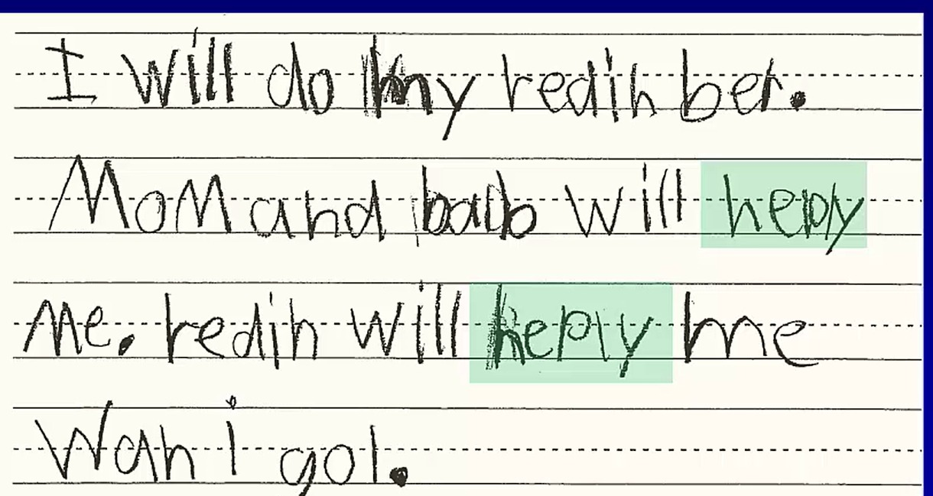
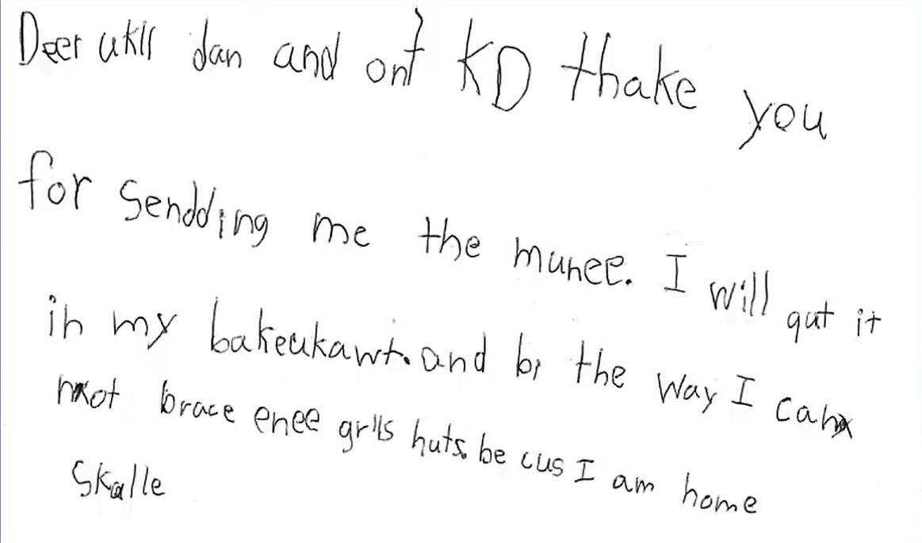

Slide 4
OUR SOLUTION
TYPING TEST
ORAL TEST
SPEAK AND TYPE
SIMILAR WORD PRACTICE

Slide 5
Report Generation
ERROR PERCENTAGE
GRAPHICAL REPRESENTATION
GRAPHICAL REPRESENTATION

Slide 6
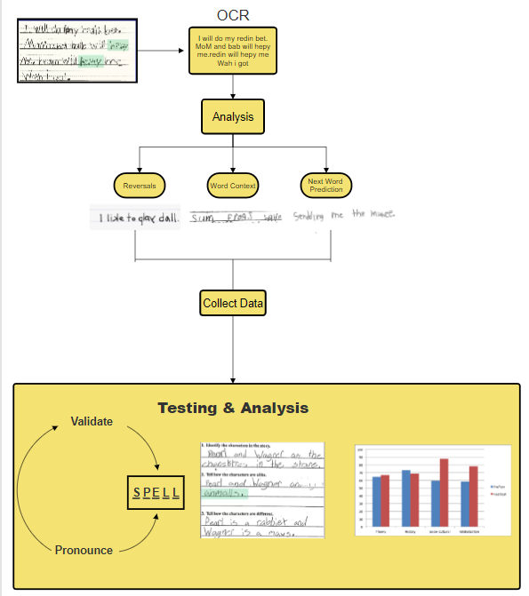
How it Works

Slide 7



